Slide 1
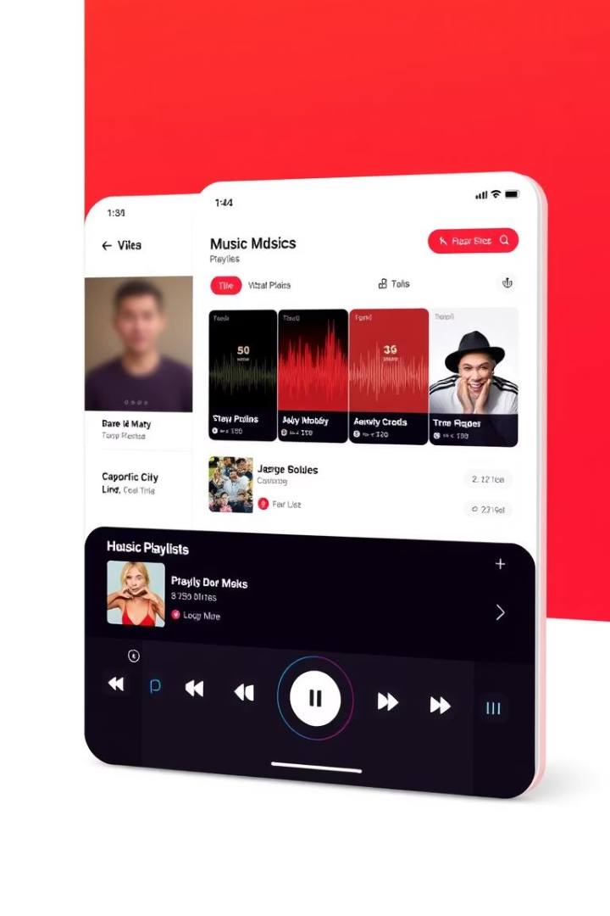
S-Ranking: Personalized Song Ranking System
The S-Ranking project aims to revolutionize how users sort and manage their YouTube playlists. As playlists grow, finding favorite songs becomes cumbersome without an efficient ranking tool. This system offers a user-centered solution by combining interactive pairwise song comparisons with an intelligent chatbot, enhancing user engagement while producing a personalized, ordered playlist.

Slide 2

Challenges in Playlist Management
Manual Sorting Limitations
Inadequate Current Tools
Preference Discovery Problem
Existing playlist sorting features lack customization and do not reflect individual preferences effectively.
Users often manually reorder large playlists, which can be tedious and slow, especially with hundreds of songs.
Identifying hidden user preferences through passive listening or static sorting is difficult.

Slide 3

Core Project Goals
1
Fetch YouTube Playlist Data
2
Implement Pairwise Song Comparisons
Automatically retrieve videos from user playlists using YouTube Data API v3 for seamless integration.
Enable users to choose preferred songs from pairs to accurately reflect personal tastes.
3
Integrate NLP Chatbot Interaction
4
Generate Personalized Ranked Playlist
Guide users conversationally to explore their preferences and simplify the ranking process.
Deliver a dynamically sorted list ordered by individual user preferences after interaction.

Slide 4
Data Collection and User Interaction
Data Collection
User Interaction
The system fetches playlist videos directly using the YouTube Data API v3, ensuring up-to-date and comprehensive song data.
Users engage by selecting their preferred song in pairwise comparisons, a process that intuitively reveals their tastes.

Slide 5
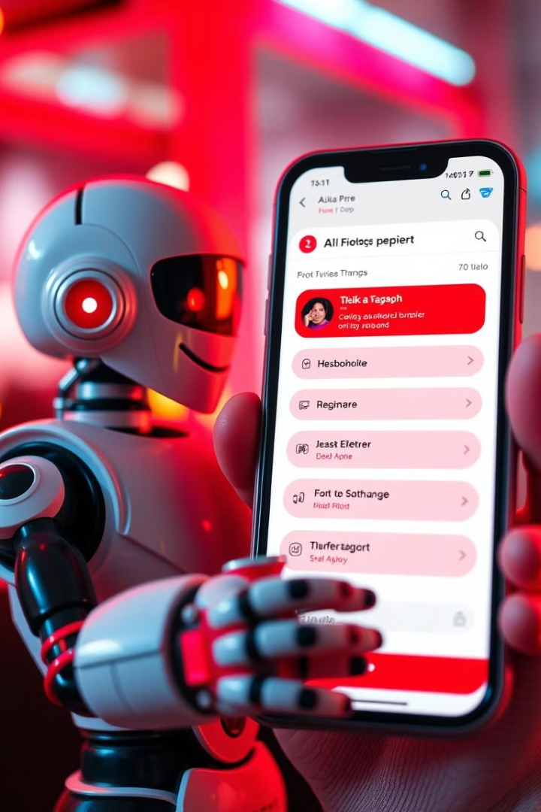



Natural Language Processing Chatbot Integration
Preference Exploration
The chatbot interacts with the user conversationally to discuss musical tastes and preferences.
Interactive Guidance
It guides users smoothly through the pairwise ranking process, making it engaging and less tedious.
Real-Time Feedback
User responses are processed instantly to tailor subsequent song comparisons dynamically.

Slide 6
Ranking Algorithm and System Architecture
Ranking Algorithm
Web Application Architecture
A merge sort based algorithm continually updates the song order based on user choices, ensuring efficient and accurate ranking.
The front-end displays pairwise song iframes for user selection, while the backend manages playlist data and applies ranking logic.

Slide 7



Results and User Experience Enhancements
Conversational Engagement
2
The NLP chatbot enriches the process, making ranking feel interactive rather than mechanical.
Dynamic Playlist Update
1
Playlist ordering updates live based on user input for immediate visual feedback.
Personalized Music Discovery
Users obtain a uniquely tailored playlist that reflects their nuanced preferences accurately.
3

Slide 8
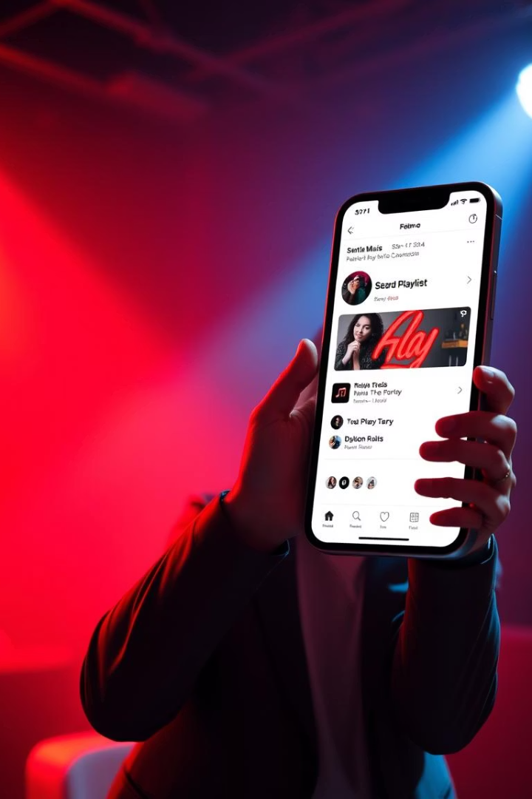
Conclusion and Future Directions
Innovative User-Centered Design
Enhanced Playlist Management
The combination of pairwise ranking and NLP chatbot offers an intuitive and engaging playlist sorting experience.
S-Ranking significantly reduces user effort while increasing satisfaction with personalized song orderings.
Potential Extensions
Future improvements could include integration with more streaming platforms and advanced preference modeling algorithms.

